Slide 1
Today’s Topic
Language of web page
- HTML (Hypertext Markup Language)

Slide 2
Hypertext & Hyperlink
Books ← written ← English
Web page ← written ← HTML.
HyperText Markup Language
Web pages are text files.
The key to hypertext is the use of hyperlinks, which allow you to jump from one topic to another.

Slide 3
What is HTML
HTML describes the content and format of web pages using tags.
Ex. Title Tag: <title>A title </title>
It’s the job of the web browser to interpret tags and display the content accordingly.

Slide 4
HTML Syntax
An HTML file contains both formatting tags and content
Document content is what we see on the webpage.
Tags are the HTML codes that control the appearance of the document content.

Slide 5
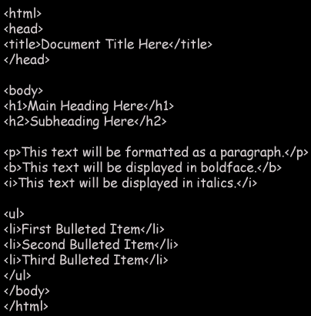
HTML FILE STRUCTURE:
What are HTML Elements?
HTML elements are represented by tags, which are enclosed in angle brackets.
Most HTML elements include a start tag, an end tag, and the content between them.
HTML elements have their own unique attributes that assign specific qualifies, such as color, to the element.
Attributes are always assigned values that are enclosed in double quotes and set equal to the attribute name.

Slide 6
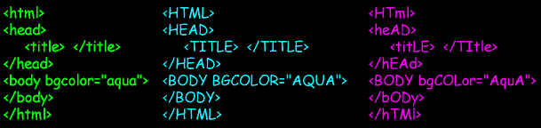

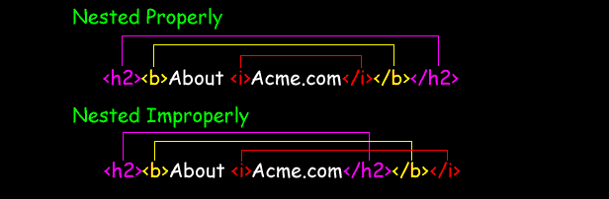
HTML FILE STRUCTURE:
What do I need to know about HTML syntax?
It is not case-sensitive.
It ignores all white space in a document other than the single spaces between words.
When you nest elements within other elements, they must close in the reverse order in which they were opened.

Slide 7
HTML Syntax
HTML syntax:
two-sided tag:
<tag attributes>document content</tag>
Closing tag
Starting tag
Properties of the tag.
Optional!
Actual content appears in webpage. It could be empty
Examples: <p> CGS 2100 </p>
<body bgcolor = “yellow”> UCF </body>

Slide 8
HTML Syntax
HTML syntax:
one-sided tag:
<tag />
e.g. Breaking line tag: <br/>
Horizontal line tag: <hr/>

Slide 9
Structure of the web page
Starting with the tag <html>...</html>
<html>
.......
</html>
Everything about the web page should be enclosed here

Slide 10
Structure of the web page
Inside the <html></html> tag
  Each web page has a head part described in <head></head> tag:
<html>
<head>
<title> CGS 2100 </title>
</head>
</html>
The title of the web page should be put here

Slide 11
Structure of the web page
Inside the <html></html> tag
  Each web page has a body part described in <body></body> tag:
<html>
<head>
<title> CGS 2100 </title>
</head>
<body>
This is a sample HTML file.
</body>
</html>
The content of the whole web page should be put here

Slide 12
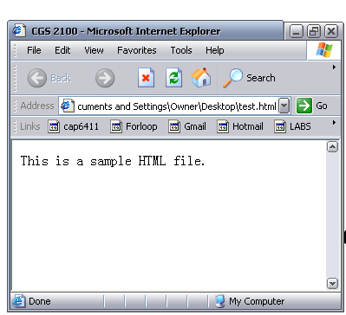
Title
Body

Slide 13
Create a basic HTML file
Open your text editor (notepad).
Type the following lines of code into the document:
<html>
<head>
<title> CGS2100 lab section</title>
</head>
<body>
This is a sample HTML file.
</body>
</html>

Slide 14
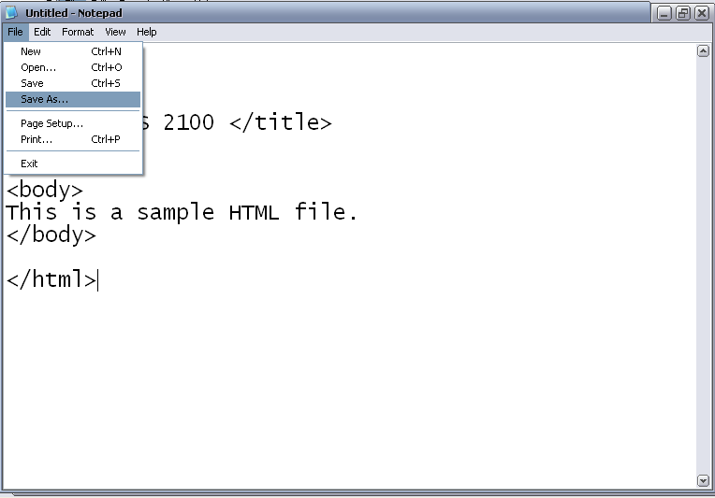
Create a basic HTML file (cont)
Save the file as sample.htm

Slide 15
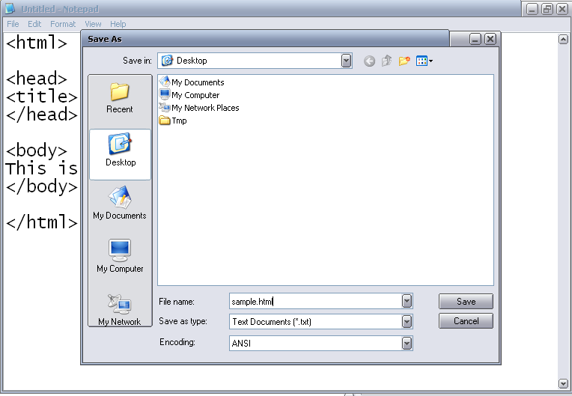
sample.html

Slide 16
Introduction to some common tags
Paragraph tag
List tag
Hyperlink tags

Slide 17
Paragraph tags <p>...</p>
<html>
<head>
<title> CGS 2100 </title>
</head>
<body>
<p> Here is the first paragraph. </p>
<p> Here is the second paragraph. </p>
</body>
</html>

Slide 18
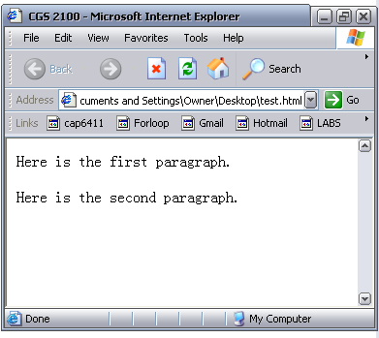
result
First paragraph
Space between paragraphs
Second paragraph

Slide 19

List tags
Ordered list: used to display information in a numeric order. The syntax for creating an ordered list is:
<ol > e.g. <ol >
<li>item1 </li> <li> Name: Your name </li>
<li>item2 </li> <li> Section: ### </li>
… <li> Instructor: Yuping </li>
</ol> </ol>
Result:

Slide 20

List tags
Unordered list: list items are not listed in a particular order. The syntax is:
<ul > e.g. <ul>
<li>item1 </li> <li> Name: Your name </li>
<li>item2 </li> <li> Section: ### </li>
… <li> Instructor: Yuping </li>
</ul> </ul>
Result

Slide 21

Hyperlink
Link to another location or file
Syntax:
<a href= “http://www.ucf.edu”> Link to UCF </a>
Content displayed on the page
Starting Tag
Attribute of the tag: the address of the hyperlink
Ending tag
Result:

Slide 22
Link
Link to web site
  <a href= “http://www.ucf.edu”> Link to UCF </a>
Link to document
<a href=“http://www.eecs.ucf.edu/images/building.jpg”>Link</a>
Email link
<a href= “mailto:name@domain.com”> Link to email </a>

Slide 23
Include a Picture
<img src=“FILENAME” />
<img src=“FILENAME” alt=“text” />
E.g.
<img src=“logo.gif” alt=“Google logo” />
<img src=“logo.gif” />

